Slide 1
PRESEASON 2022-23
DAN NADEAU
207-446-5730
nadmar98@yahoo.com

Slide 2
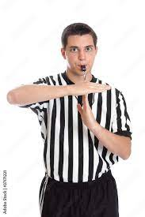
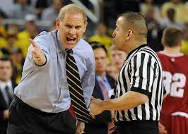
IT’S TIME FOR BASKETBALL SEASON

Slide 3
UNIFORMS
NFHS Basketball Rules Book (RULE 2-1)
Black & White Striped Shirt
Black Pants - Slacks (no wind pants or sweatpants)
PRIMARILY Black Shoes and Socks
Black Warmup Jacket (OPTIONAL – REGULAR SEASON)

Slide 4
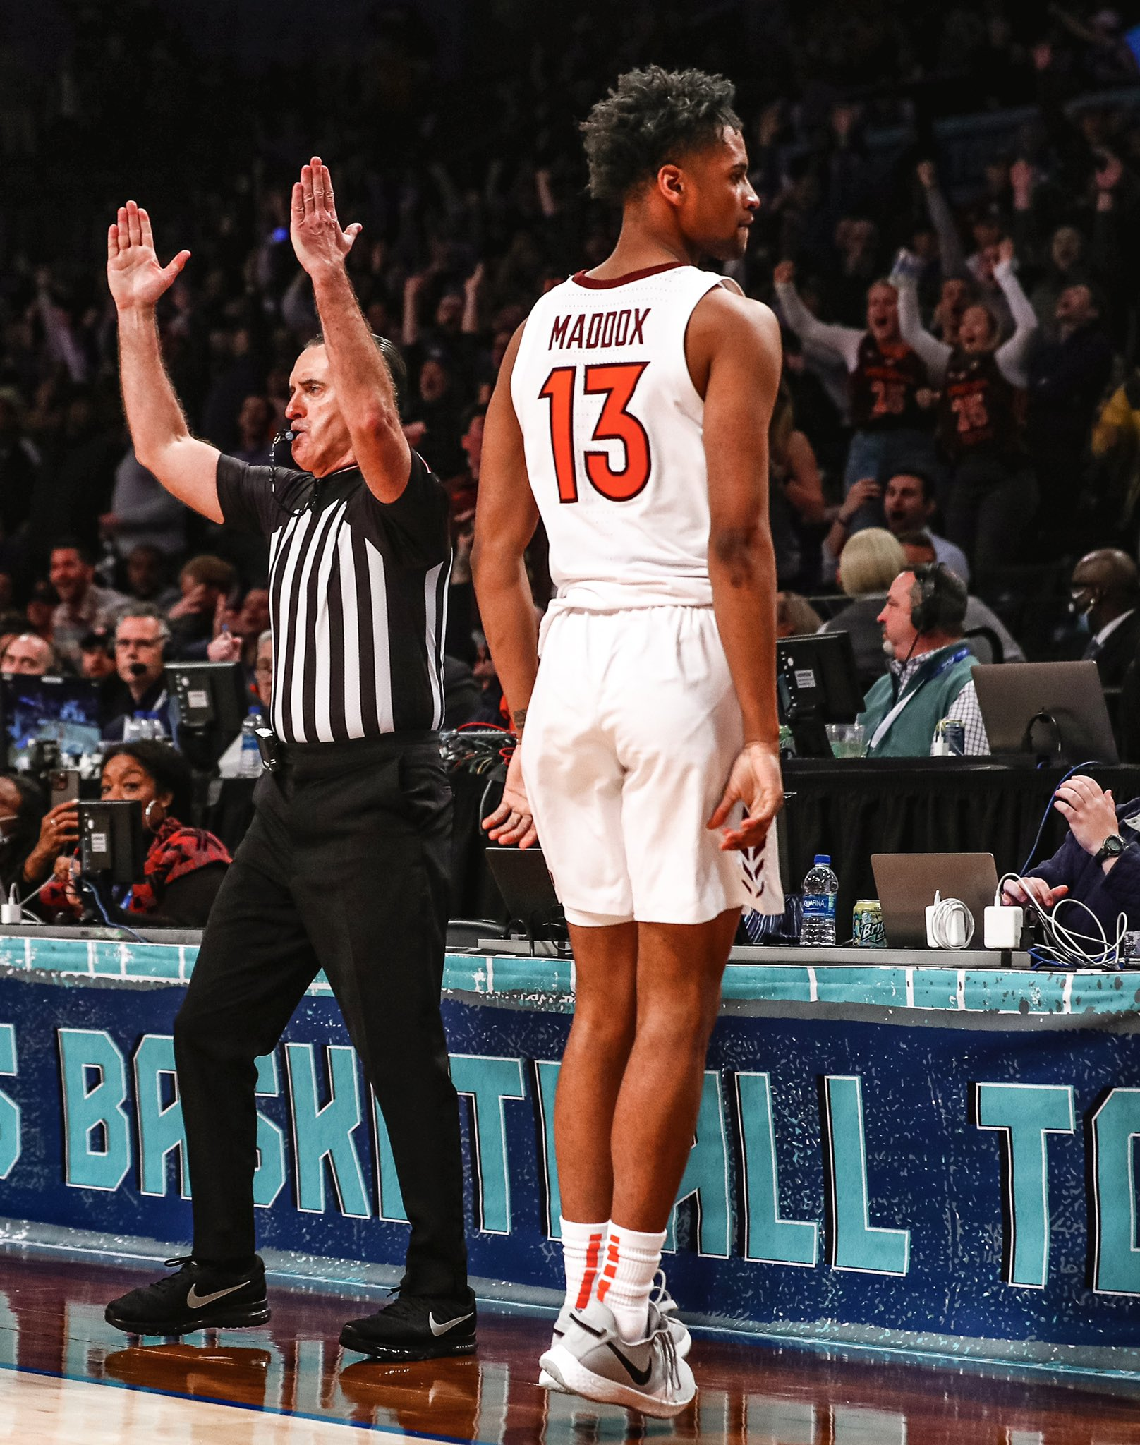

Slide 5
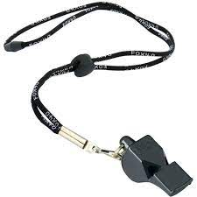
WHISTLE
FOX 40

Slide 6
WHERE TO BUY
WWW.BLOWYOURWHISTLES.COM

Slide 7
HOW DO I GET GAMES?
New Officials
Floor Education sessions
BOARD #20 ASSIGNOR
Dave Tourtelotte
Check your emails often
Are you ready to be assigned in ARBITER?
ARBITERSPORTS.COM

Slide 8
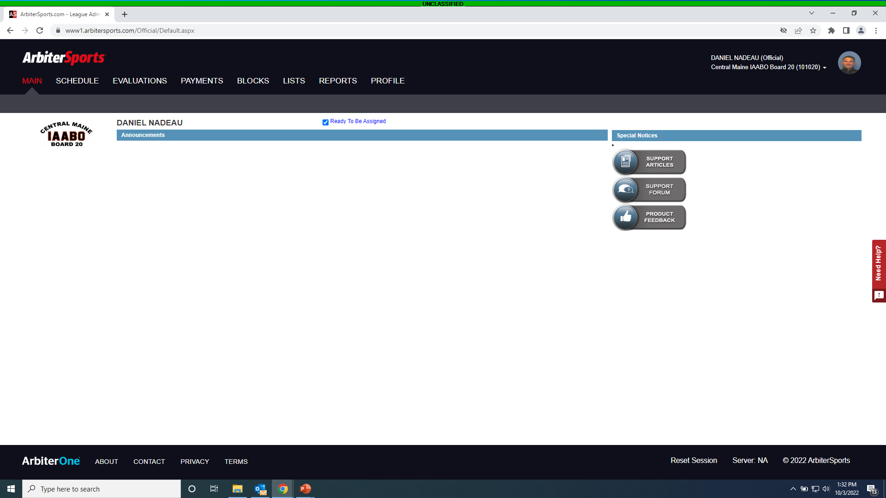

Slide 9
I HAVE GAMES ASSIGNED… NOW WHAT??
Accept or Decline assignments in a timely manner?
Are you managing your Open/Blocked Dates?
Contact your partner at least 24hrs before the game.
Arrival
Location
Game Time

Slide 10
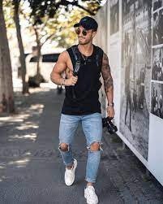
WHAT SHOULD I WEAR TO GAMES?

Slide 11
ACCEPTABLE ATTIRE
Business Casual - MOST ACCEPTABLE
No Jeans
Sweatpants
Joggers
Yoga Pants
Some Situations Dictate Attire
Employment
Last Minute Assignment
BE PROFESSIONAL

Slide 12
ARRIVAL AT GAME SITE

Slide 13
ARRIVAL AT GAME SITE
MS/Sub Varsity arrive at lease 30 min before game time
For make sure dressed and on floor 15min prior to start of the game
Varsity Games – Arrive at least 45min before start time
Find the Athletic Administrator
Sit with your partner away from coaches/fans
Varsity - Be in the locker room at the beginning(ish) of 4th quarter.

Slide 14
PREGAME
Bruh…… Nobody does pregame anymore!!
Said by: Almost Everyone
An Abbreviated Pregame??
PCA/ Line Coverage
Eye Contact/Designated spots
Double Whistles
Contact on ball handler/shooter
Bench Decorum/Odd Situations

Slide 15
PREGAME ON THE COURT
Observe Team & Players
Identify pivot foot and moves off dribble
Post Play Or 3pt Shooting
Keep conversations short with each other
Refrain from chatting with spectators
Meet with Table Crew and go over possible scenarios
Coaches & Captains Meeting
Keep it brief
Ask the 3 questions to coaches and players

Slide 16
DURING THE GAME
Are we in shape to officiate? Can we keep up with the play?
Are we happy to, “Be there?”
What’s our body language saying?
Do we know the rules?
Do we use proper signals?
Do we use proper mechanics?
Do we disarm coaches if it’s not our ruling

Slide 17
DURING THE GAME
Do we back our teammates?
Coach’s comments
Do we help pickup our crew members who are having a tough night, had a tough ruling?
Do we show good leadership?
Do we manage major moments together?
Do we get together and stay focused at the end of the game

Slide 18
AFTER THE GAME
Ask Partner for Feedback
Partners should give constructive feedback
Double check afterwards
REPORT ANY TECHNICAL FOULS
Must contact Interpreter after the game with ANY ejections

Slide 19
POST GAME CONFERENCE CENTER

Slide 20
OTHER ITEMS TO THINK ABOUT

Slide 21
CONCUSSION PROTOCOLS (Pg. 85 Rulebook)
When an athlete exhibits signs, symptoms or behaviors consistent with a concussion, that athlete shall be immediately removed from the contest and shall not return to play until cleared by an appropriate health-care professional.
Dazed or Stunned appearance
Officials are not to diagnose injuries but should remove the athlete and notify the coach. Allow the health-care professional to determine the outcome of the injury.

Slide 22
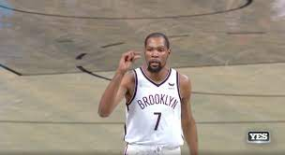
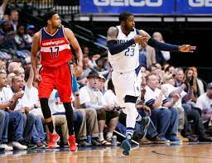
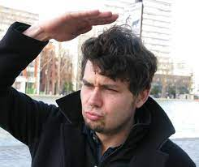
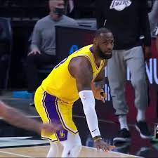
UNSPORTING CONDUCT
Not only comments or Foul Language
Gestures
Throwing Items or Stomping
Anything else that is deemed “UNSPORTING”

Slide 23
HOUSE KEEPING
Stay on top of proper/improper equipment & uniform issues all season.
As the season progresses, so does our personal life. REMEMBER TO KEEP UP ON BLOCK DATES IN ARBITER
This is an avocation, make sure you are having fun with it

Slide 24
GOOD LUCK THIS SEASON
STAY HEALTHY!!

